Slide 1




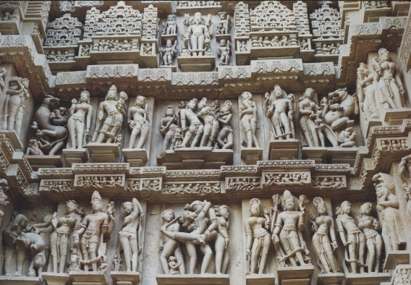
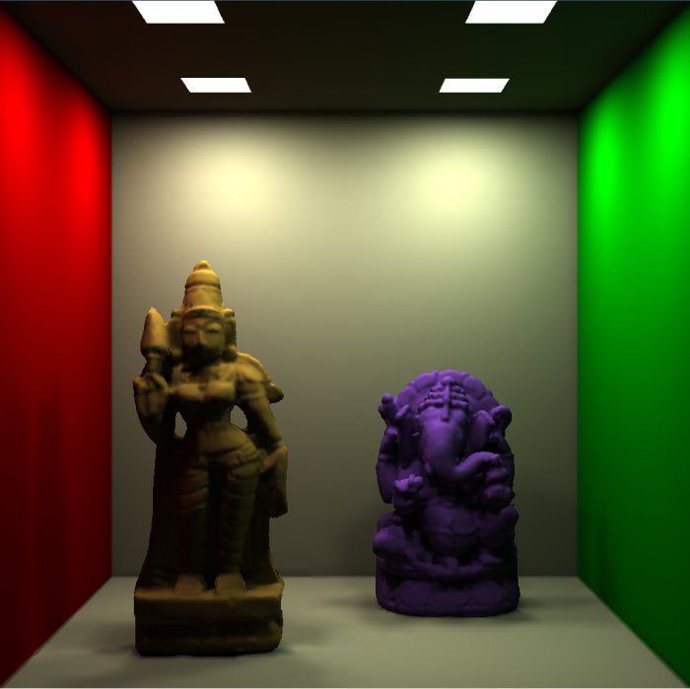
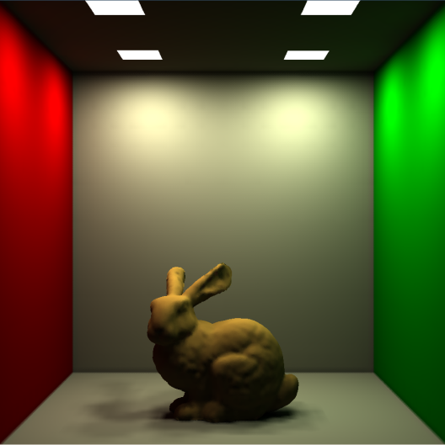
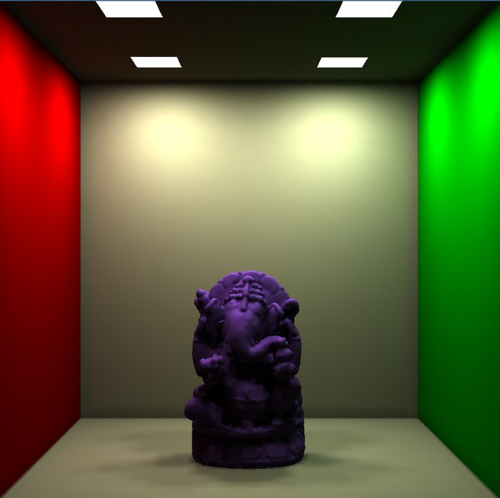
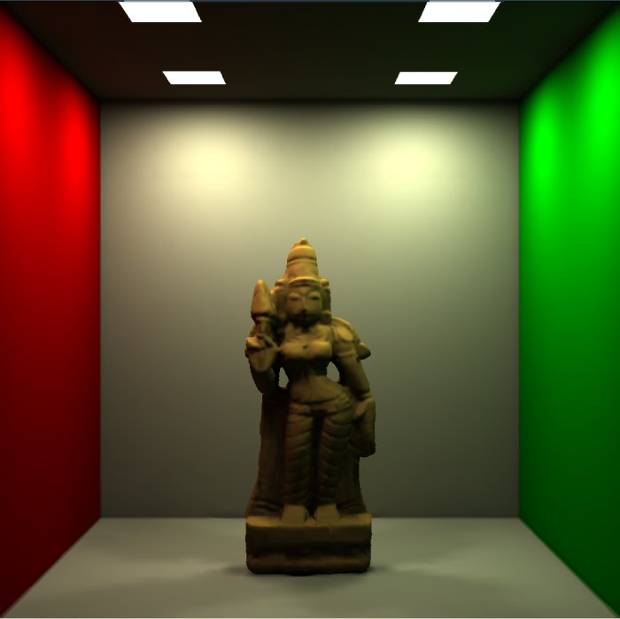
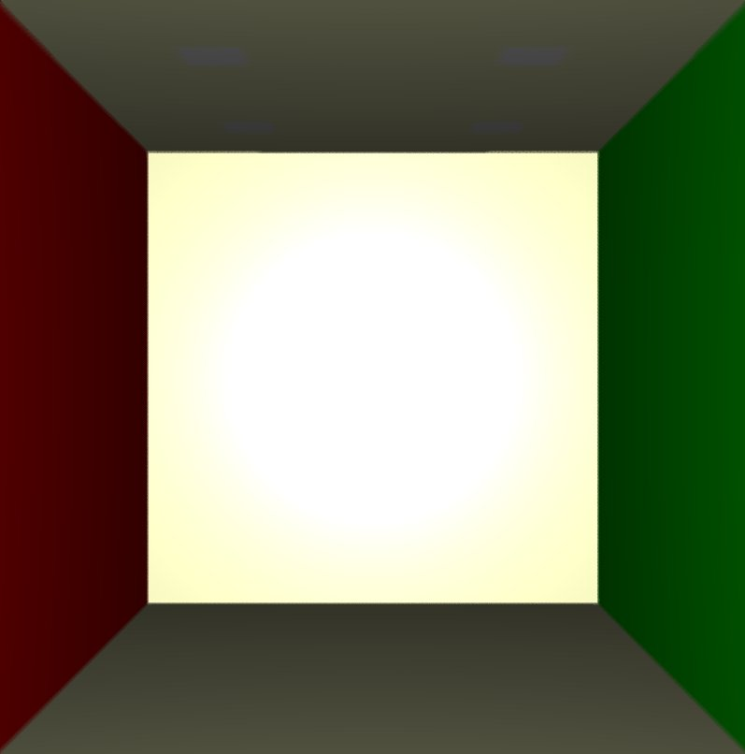
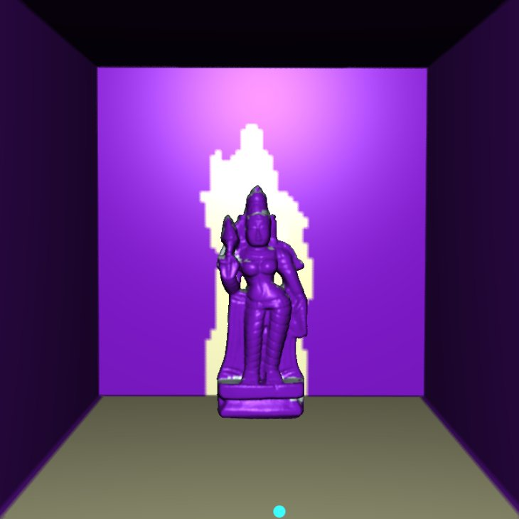
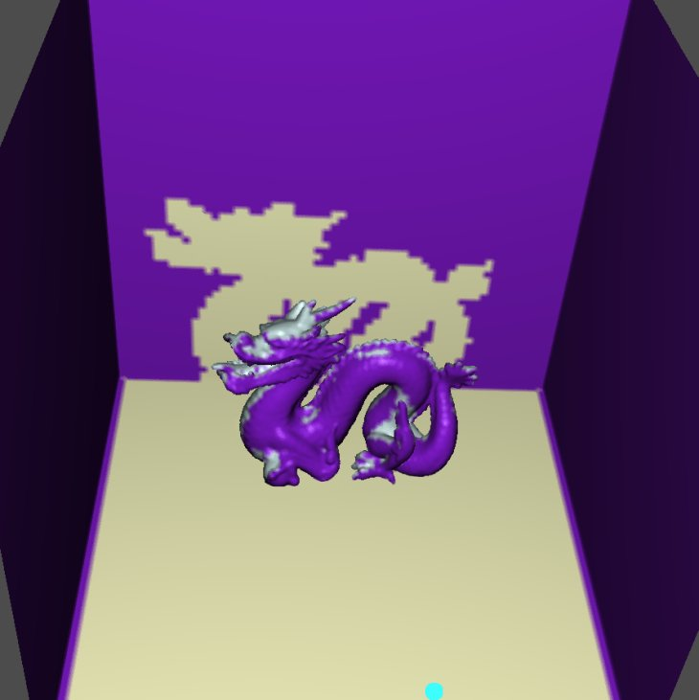
GPU based Global Illumination of Point Models using FMM
Rhushabh Goradia, Prekshu Ajmera, Sharat Chandran | ViGIL IIT Bombay
{rhushabh, prekshu, sharat}@cse.iitb.ac.in
Motivation
Scans of cultural heritage structures involve millions of points
Seamless, geometrically consistent mesh creation is virtually not possible as it is difficult to automatically segment different objects
Wish to preserve in a virtual museum and view them under novel, complex lighting conditions
Problem Statement
Capturing radiosity based inter-reflection effects in a scene when the inputs are point samples of hard to segment entities
Exploit the inherent parallelism in the proposed solution using CUDA based GPU techniques to achieve fast solutions
Global Illumination and Visibility
Computing visibility between a point-pair is difficult due to lack of intermediate surface information
Contributions
View-Independent visibility solution between point-pairs required for computing correct global illumination
Radiosity solution for complex point models using the Fast Multipole Method
Exploit parallelism in the proposed algorithm to achieve upto 20x speed-up using GPUs
Fast Multipole Method
FMM is concerned with evaluating the effect of a “set of source points” Y, on a set of “evaluation points” X
Total complexity : O(NM)
FMM attempts to reduce this irreducible complexity to O(N+M)
The three main insights that make this possible are
  Factorization of the kernel into source and receiver terms
  Many application domains can tolerate approximations
  upto a certain level
  Clever use of hierarchical structure (Octree)
Each node has an associated Interaction List
Radiosity-based Global Illumination
A N-body problem
FMM: The Technique
Phases of FMM
Octree Construction
Interaction List Construction
Point-Pair Visibility
Upward Pass
Downward Pass
Final Summation Stage
[Karapurkar A., Chandran S., ICVGIP 2004]
Assigning Weights to Points
Requires integration over a surface area
For Point Based Models, we do not have any surface information; we therefore approximate this integration
Weights are assigned to each point and signify the contribution of the point to the reconstruction of the surface
Local property based on the normal available at points. As the number of points increase, the integration is computed more accurately
Visibility Map Construction
In general, it is advantageous to have links at high level in the tree
Leaf-Leaf Visibility
Parallel Octree Construction on GPU
Parallel V-map Construction on GPU
Parallel FMM on GPU
Qualitative Results
Quantitative Results
Root
Root
Complete
Visibility
Root
Partial
Visibility
Root
B
A
B
A
B
A
New Visibility
Link
B
A
New Visibility
Link
a₁
a₂
a₃
a₄
b₁
Lookup
Lookup
Lookup
Lookup
Compute Visibility in Parallel & Store in LVS
Lookup from LVS
Upward pass Step 1
Upward pass Step 2
Empty
Empty
p
I
q
p
q
Downward pass Step 1
Downward pass Step 2
Visibility in Polygonal Models
Visibility in Point Models
Level 2
Level 3
The visibility map (or V-map) for a tree is a collection of visibility links for every node in the tree. The visibility link for any node p is a list L of nodes at the same level; every point in any node in L is guaranteed to be visible from every point in p
The visibility map is constructed recursively by a variation of DFS
Level 3
Level 2
Level 1
Final Summation Step
V2
Visible
Node N
V1
Visible
Visible
V3
V4
Visible
Node N
V1
V2
V3
V4
Root
Complete
Visibility
Root
Partial
Visibility
Root
Root
CPU
GPU
A
B
A
B
A
B
A
B
a₁
a₂
a₃
a₄
b₁
New Visibility
Link
New Visibility
Link
a₂
b₁
Lookup
Lookup
Lookup
Lookup
Octree Construction
Compute Visibility
Compute Visibility
n_{x}
n_{y}
c₂
c₂
c₂
x
r_{x} – r_{y}
y
cz
q
cz₂
r_{x}
r_{y}
p
c₂
c₁
c₂
c₁
cz₁
V-map Construction
o
c₁
c₁
cz₁
cz₂
c₁
Phases of FMM

